Slide 1

Financial Risk Management
Spring 2016
Dr. Ehud Peleg
Maximum Likelihood Estimation

Slide 2
Agenda
Likelihood function
Maximum Likelihood Estimation
Applying MLE to Volatility Models
Confidence Intervals
Likelihood Ratio Tests

Slide 3
Likelihood Function - Example
Suppose we draw one number from a normal distribution, what is the probability density function, if we know μ=1 and σ=3?
Suppose we don’t know μ and σ, but the number we draw is 1. What is the likelihood?

Slide 4
Maximum Likelihood Estimator
Suppose our data: are a realization from a joint probability density .
is the vector of parameters of the density function.
The likelihood is:
i.e. a function of where the observed data are known.
In maximum likelihood methods, we find the parameters that maximize the likelihood of the observed sample.

Slide 5
Log Likelihood for iid Data
Typically, we prefer to maximize log-likelihood rather than likelihood.
If the data are i.i.d. then we have:
The parameters that maximize this function can be shown to be good estimators of the true parameter.

Slide 6
Likelihood for iid data example
Suppose we draw 3 numbers from a Normal distribution: 1, -2, 3.
Suppose we know mean = 0. The free parameter is ν, the variance.
What is the log likelihood?
MLE will be ν that maximizes this expression.

Slide 7
Simple MLE Example
We observe that a coin falls on heads one time in ten trials. What is our estimate of the probability, p, of a coin falling on heads?
The likelihood of the outcome is:
Let’s look at the first order condition to find the maximum.

Slide 8
Simple MLE Example (cont.)
Suppose we observed two heads in 10 tosses, what is the MLE?
The likelihood of the outcome is:
Let’s look at the first order condition to find the maximum.

Slide 9
MLE for N(0, ν)
Estimate the variance, ν, from n observations, u₁…u_{n}, drawn from a normal distribution with mean zero:
Likelihood:
Log Likelihood:
FOC:
MLE:

Slide 10
MLE and Time Varying Volatility
Models like GARCH(1,1) and EWMA assume that daily returns are Normal with mean zero and volatility, ν_{i}.
Note, this is the distribution conditional on all previous daily returns
Later, we will relax the Normal assumption with wider tail distributions
The likelihood is now:

Slide 11
MLE for N(0, ν_{i})
We choose parameters that maximize, where now volatility is changing each day:
For the models we previously discussed:

Slide 12
MLE for N(0, ν_{i}) – cont.
For EWMA – We estimate λ.
For GARCH(1,1) - We can:
Estimate three parameters (α, β, ω=γV_{L})
Or, assume the the long-run average volatility (V_{L}) equals to the sample variance and estimate only two parameters using MLE. This is called: Variance Targeting

Slide 13
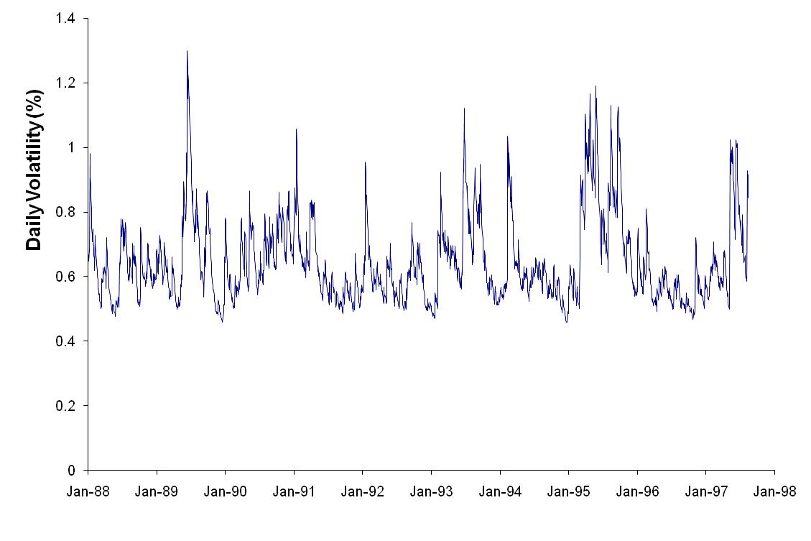
Daily Volatility of Yen: 1988-1997

Slide 14
Estimating GARCH(1,1)
Day | S_{i} | u_{i} | v_{i} =σ_{i}² | -ln v_{i}-u_{i}²/v_{i}
1 | 0.007728
2 | 0.007779 | 0.006599
3 | 0.007746 | -0.004242 | 0.00004355 | 9.6283
4 | 0.007816 | 0.009037 | 0.00004198 | 8.1329
5 | 0.007837 | 0.002687 | 0.00004455 | 9.8568
….
2423 | 0.008495 | 0.000144 | 0.00008417 | 9.3824
 |  |  |  | 22,063.5833
Assume estimates for alpha, beta and omega.
Compute
Compute likelihood and sum across all days.
Let optimizer find the parameters to maximize likelihood

Slide 15
Programing MLE Estimator
Write likelihood function:
Takes parameters as inputs
Computes the likelihood given the data
Call a minimization/maximization algorithm such as optim in R or fminunc in Matlab

Slide 16
Asymptotic Properties of MLE Estimator
It can be shown that:
I(θ) is called the Fisher Information:
We use a sample estimate of the Fisher Information:

Slide 17
Confidence Interval for MLE Estimator
This allows us to test hypotheses and build confidence interval around our estimate, if n is large enough.
The standard error of the estimator is:
The (1-α) confidence interval for is:

Slide 18
Hypothesis Testing using MLE
We can test the hypothesis at level α:
By forming a standard normal:
Reject H₀ if:

Slide 19
Normal Distribution Example
The log likelihood:
FOC:
MLE Estimator:
Fisher Information:
With:
Standard Error:

Slide 20
Normal Distribution – Cont.

Slide 21
Likelihood Ratio Test
Suppose we want to test the hypothesis that some constraints on the parameters hold:
For example, μ = 0.
We can compute the Maximum Likelihood given the constraints, and compare it to the Maximum Likelihood without constraints.
What gain in Maximum Likelihood are we giving up by the constraints?
The following asymptotically holds:
m is the number of effective constraints.

Slide 22
Normal Distribution – L.R. Test
Unconstrained:
Constrained:
Reject at 5% if LR>3.841
Other rejection boundaries: 6.635 at 1%, 2.706 at 10%

Slide 23
Homework
Daily EUR data from 2/5/14 – 2/5/15
Estimate EWMA parameter λ using MLE
Test whether λ is different from 0.96 using Likelihood Ratio Test.

Slide 24
Thanks

